Slide 1
OSHA Training
ATTAIN HOME CARE LLC

Slide 2
POLICY
It is the policy of DHS that Attain Home Care provides training periodically and follow universal precautions and sanitary practices, including hand washing, for infection prevention and control, and to prevent communicable diseases.

Slide 3
PROCEDURES for Universal Precautions, Sanitary Practices and Prevention
Use of proper handwashing procedure
Use of gloves in contact with infectious materials
Use of a gown or apron when clothing may become soiled with infectious materials
Use of a mask and eye protection, if splashing is possible
Use of gloves and disinfecting solution when cleaning a contaminated surface
Proper disposal of gloves
Use of gloves and proper bagging procedures when handling and washing contaminated laundry

Slide 4
Control of Communicable diseases
Staff will report any signs of possible infections or symptoms of communicable diseases that a person receiving services is experiencing to Rachel Weidner
When a person receiving services has been exposed to a diagnosed communicable disease, staff will promptly report to other licensed providers and residential settings.
Staff diagnosed with a communicable disease, may return to work upon direction of a health care professional.

Slide 5
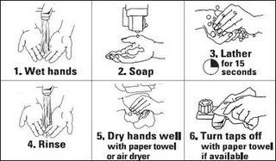
Proper Handwashing Technique
This Photo by Unknown Author is licensed under CC BY-NC-ND

Slide 6

Protective Gear
This Photo by Unknown Author is licensed under CC BY-ND

