Slide 1
MRSA /INFECTION CONTROL
ATTAIN HOME CARE LLC

Slide 2
What is MRSA Bacteria
Is a strain of staph bacteria that has become resistant to antibiotics commonly used to treat infections. Name is Methicillin-Resistant Staphylococcus aureus.
Occur from health-care settings
General population
Spread from skin to skin contact
High school, college wrestling, child care workers, and crowded locations

Slide 3
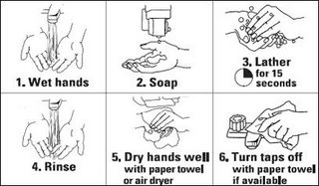
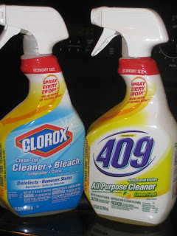
How to kill MRSA Bacteria
Wash Wash Wash!
Bleach or other disinfectant

Slide 4
What to use disinfectant on?
Hands- use hand sanitizer if soap and water are not available
Surfaces- door handles, phones, computer, keys, light switches and other surfaces commonly used
Wash sheets and towels regularly – wear gloves and use the hottest setting, dried hot

Slide 5
How is MRSA spread??
MRSA enters through: Lungs, nose, mouth, open cuts on your skin, wounds and surgical sites.
Direct skin to skin contact with people (wear gloves if possible)
Touching contaminated surfaces
Through the air
Non active MRSA carriers can spread to others causing infections
Pets can also get these infections

Slide 6
Is MRSA contagious? YES!
Babies, children, young, and the old, rich and poor. The young and elderly are more at risk because of immune systems are not as strong.
Spread
**The infection needs to get inside of your body to cause an infection
***Risk factors: your age, medical conditions, stress level, amount of exposure, route of exposure (into open cut on your body), a history of recurring infections, medications that suppress your immunity

Slide 7
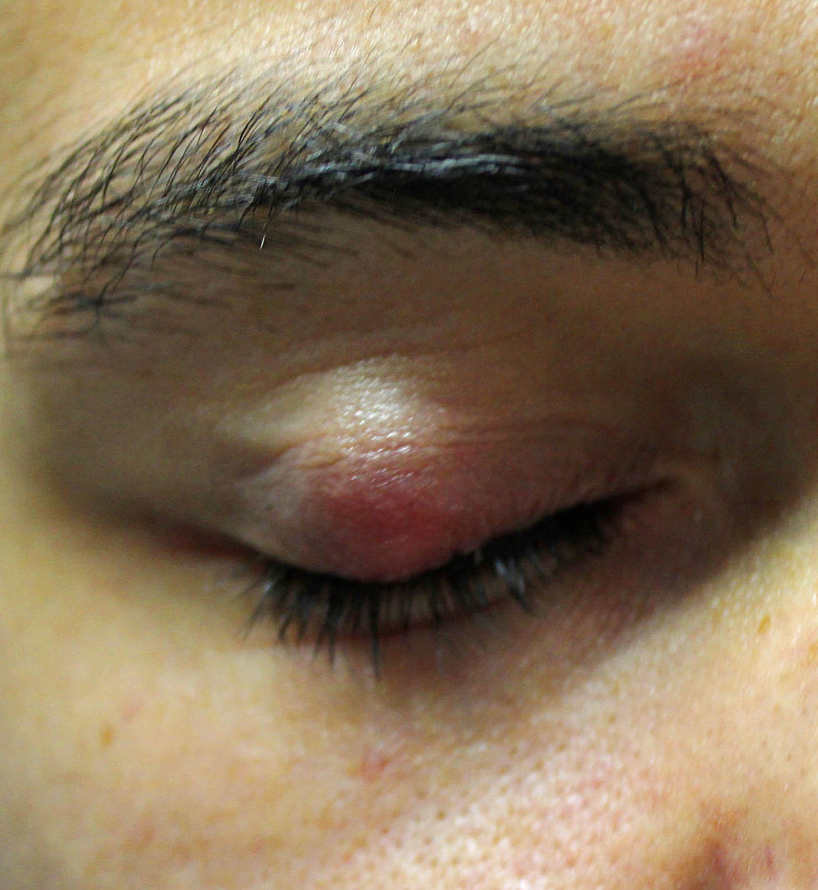
Symptoms of MRSA
Boils
Rashes
Red pus filled bumps
To severe cellulitis
This Photo by Unknown Author is licensed under CC BY-SA

Slide 8
How long does MRSA bacteria live?
MRSA can live for weeks on counters, doors knobs, toys, furniture, sports equipment, TV remotes, and the list goes on.
When alive; the bacteria can spread to people or pets from any surface
Temperature plays a factor in it. Humid areas keeps bacteria alive.
Roughly 30% of people carry Staph (and a smaller percent carry MRSA) bacteria on their skin and don’t even know it

Slide 9
Source
Faber. J. (2017). How to Kill MRSA Bacteria. Staph Infection Resources.com. Port Townsend, WA.

